Slide 1
Question 3
STAT 341 Assignment 4
Sheen Thusoo | 20728766

Slide 2
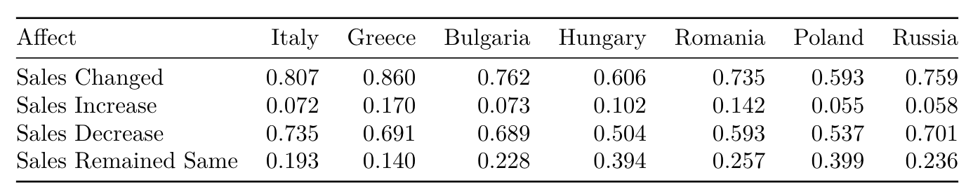
Were The Sales Affected By COVID-19 Pandemic Policies In Italy, Greece, Bulgaria, Hungary, Romania, Poland, And Russia?

Slide 3

If The Sales Were Affected, Has The Effect Been Similar Or Different Between Countries?
Significance Test
H₀: The sub-populations P₁ and P₂ were randomly drawn from the same population
Variate: Percentage by which sales decreased
Discrepancy Measure: Absolute Difference of Averages

Slide 4
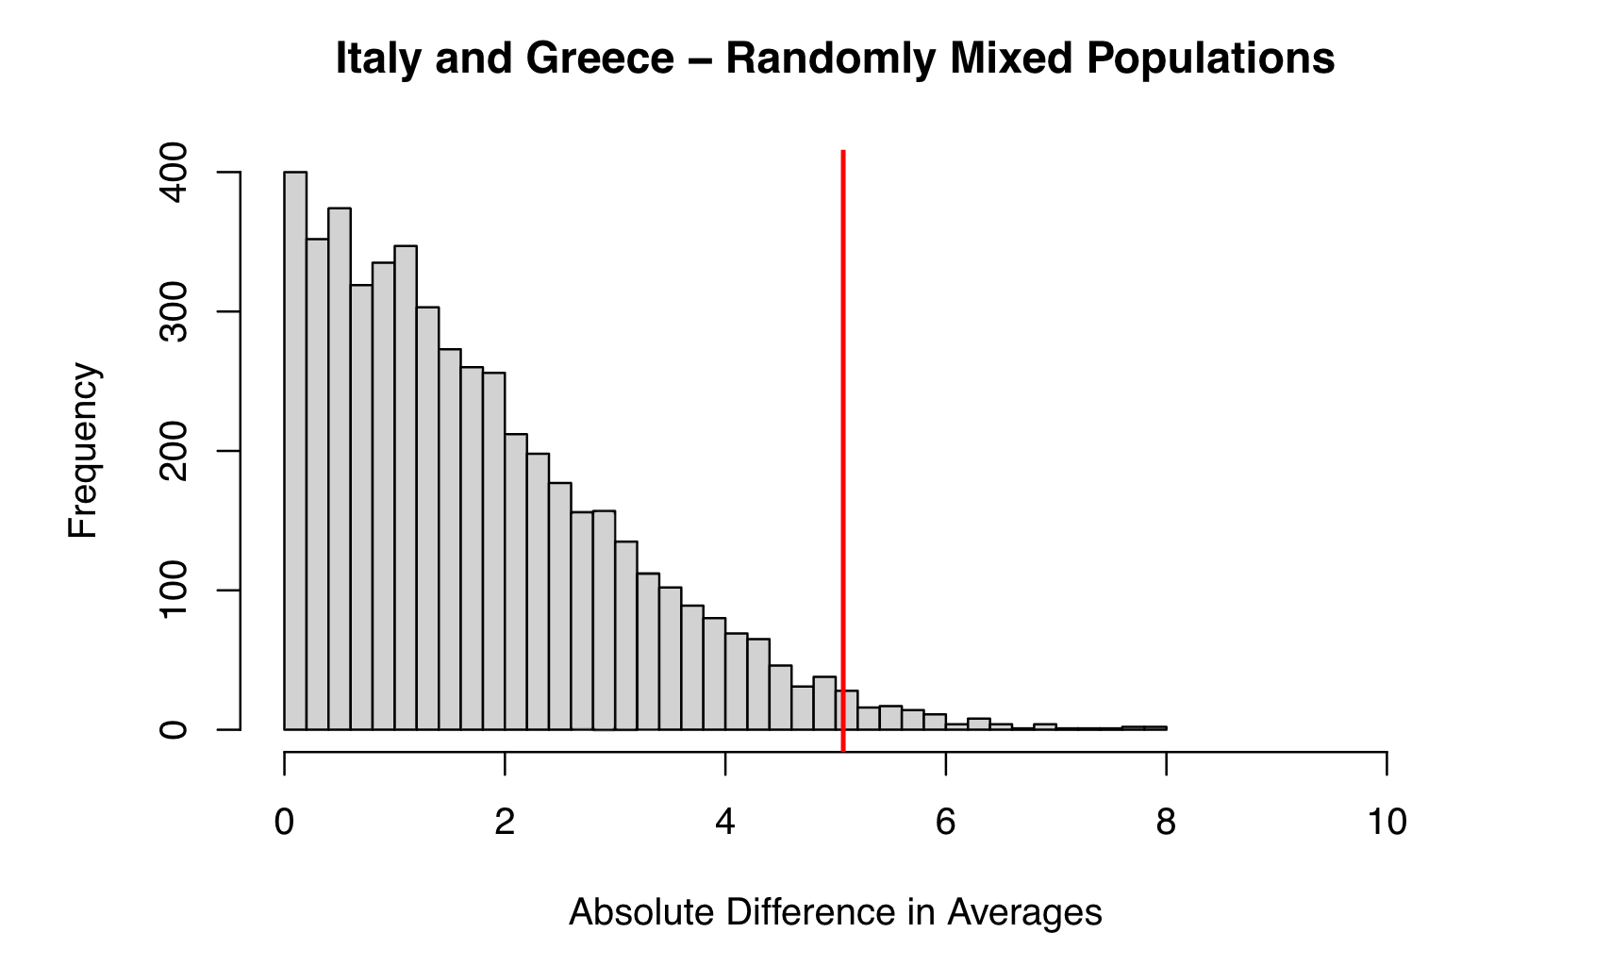
Italy vs. Greece
p-value : 0.0198

Slide 5
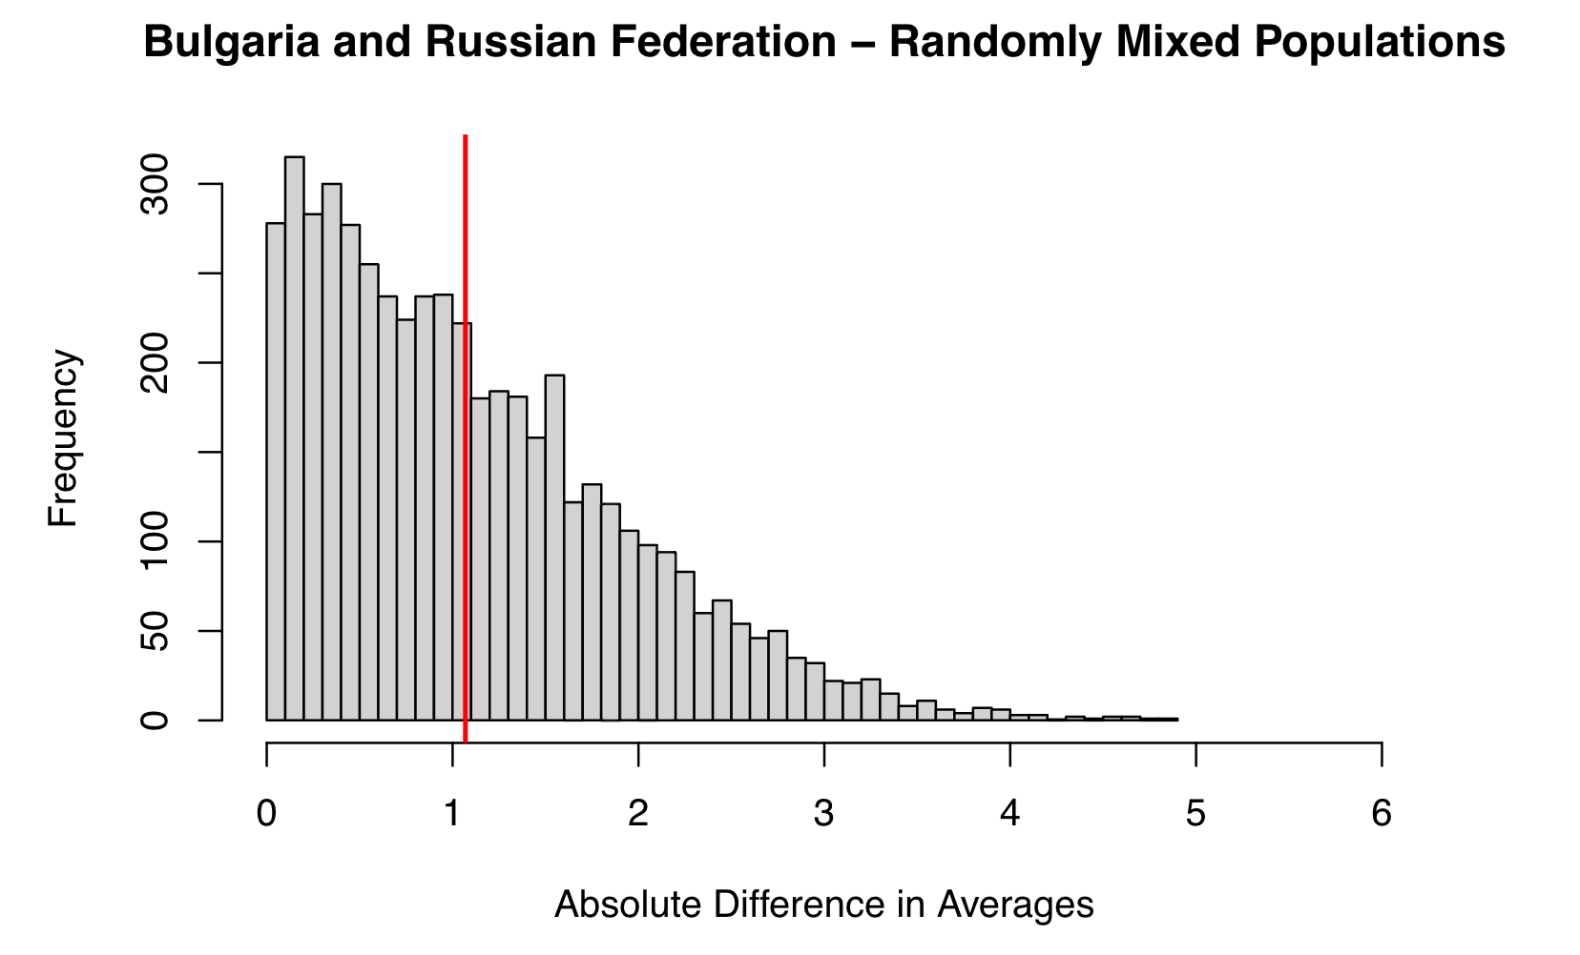
Bulgaria vs. Russia
p-value : 0.4422

Slide 6
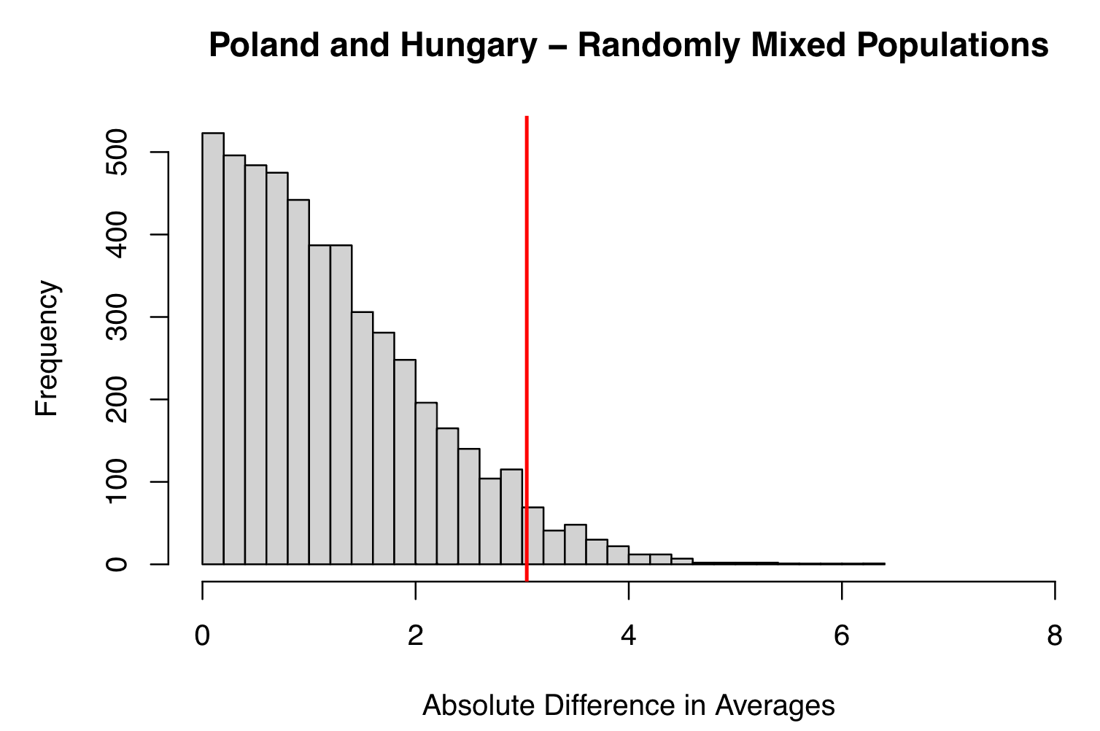
Poland vs. Hungary
p-value : 0.0464

